Slide 1

CINEMAX MULTIPLEX PVT. LTD.
Movie Theatre Revenue & Operations Analytics
Power BI Dashboard | Executive Stakeholder Briefing
Presented by: Malathi R
Regional Operations Director & Business Stakeholders
Notes:
Good morning everyone, and thank you for your time. I'm Malathi, and today I'll walk you through our new Power BI dashboard for CineMax Multiplex — built to give us one clear, centralized view of revenue and operations across all our theatres in Tamil Nadu. In the next five minutes, I'll cover the business problem we're solving, what the dashboard shows, the key insights, and what we recommend doing next.

Slide 2






BUSINESS CONTEXT
Business Background
CineMax Multiplex operates multiple theatres across Tamil Nadu, running hundreds of shows every week across genres, cities, and price points.
As the chain has grown, management needs a single, centralized dashboard to monitor performance and make faster, better-informed decisions — instead of piecing together separate reports from every location.
Tamil Nadu Network
Multiple CineMax theatres operating across the state
WHAT MANAGEMENT NEEDS TO SEE, IN ONE PLACE
CineMax Velachery
CineMax Katpadi
CineMax Trichy
Revenue
Occupancy
Movie performance
CineMax Anna Nagar
CineMax Salem
Food sales
Promotions
Theatre performance
CineMax Erode
CineMax Multiplex Pvt. Ltd. | Revenue & Operations Analytics
2
Notes:
CineMax isn't a single cinema — we run multiple theatres across Tamil Nadu, from Chennai to Trichy to Salem. That scale is great for business, but it makes it hard to keep track of everything. Management needs one centralized place to see revenue, occupancy, how movies are performing, food and beverage sales, promotions, and how each theatre stacks up — instead of chasing separate spreadsheets from every location.

Slide 3




THE CHALLENGE
Problem Statement
Today, decision-making is slowed down by scattered, manual, and incomplete reporting.
No centralized reporting
Difficulty tracking revenue
Data lives in separate files across theatres and teams.
Hard to see true revenue trends as they happen.
Inconsistent theatre performance
Limited visibility into occupancy
No easy way to compare theatres side by side.
Seat utilization is not tracked consistently.
Difficult to evaluate promotions
Time-consuming manual reporting
Unclear which offers actually drive revenue.
Hours spent compiling reports instead of acting on them.
CineMax Multiplex Pvt. Ltd. | Revenue & Operations Analytics
3
Notes:
So what's actually going wrong today? There's no single source of truth — reporting is scattered across locations, so tracking revenue in real time is difficult. Theatre performance is inconsistent and hard to compare. We don't have clear visibility into how full our shows really are, we can't easily tell which promotions are working, and a lot of manager time goes into building reports manually instead of acting on insights.

Slide 4

WHY WE BUILT THIS
Project Objectives
The dashboard was designed around six clear goals for the business.
Monitor total revenue
Track theatre occupancy
Analyze movie genres
Real-time visibility into ticket, food, and tax revenue.
Understand seat utilization across every location.
See which genres drive the most business.
Measure food revenue
Compare theatre performance
Support data-driven decisions
Quantify the contribution of concessions sales.
Benchmark theatres against one another.
Give leadership one trusted source for decisions.
CineMax Multiplex Pvt. Ltd. | Revenue & Operations Analytics
4
Notes:
With that in mind, we set six objectives for this dashboard: monitor total revenue as it comes in, track occupancy at each theatre, understand which movie genres perform best, measure how much food and beverage adds to revenue, compare theatres against each other fairly, and ultimately give leadership one trusted, data-driven foundation for decisions — instead of gut feel.

Slide 5

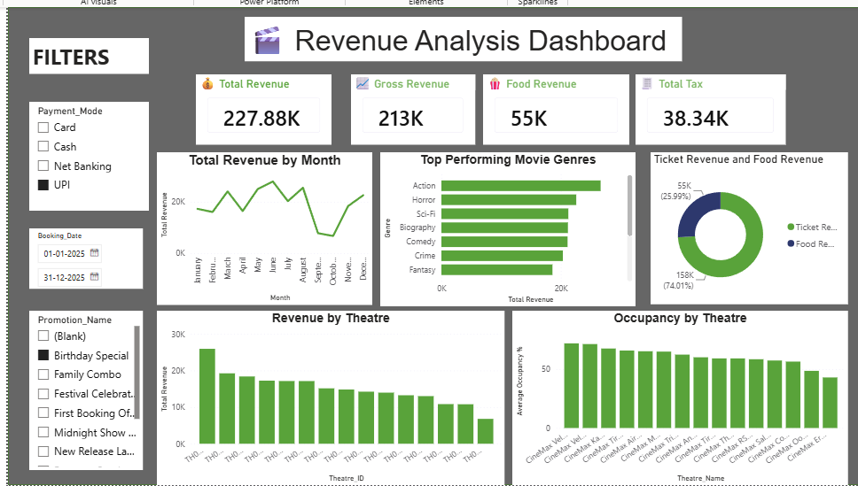
THE SOLUTION
Dashboard Overview
Total Revenue
Gross Revenue
Food Revenue
Total Tax
227.88K
213K
55K
38.34K
WHAT EACH VISUAL SHOWS
Revenue by Month — seasonal trend across the year
Top Movie Genres — revenue ranked by genre
Ticket vs Food Revenue — income mix split
Revenue by Theatre — location-wise comparison
Occupancy by Theatre — average seat utilization
FILTERS AVAILABLE
Payment Mode • Booking Date • Promotion Name
Lets any stakeholder slice the data instantly, without needing a new report.
CineMax Multiplex Pvt. Ltd. | Revenue & Operations Analytics
5
Notes:
This is the heart of it — our Revenue Analysis Dashboard in Power BI. At the top, four cards give an instant pulse check: total revenue of 227.88K, gross revenue of 213K, food revenue of 55K, and total tax of 38.34K. Below that, we can see revenue trending month by month, which genres perform best, how ticket and food revenue split, and how every theatre compares on revenue and occupancy. And on the left, filters let anyone slice this by payment mode, date, or promotion in seconds.

Slide 6
WHAT THE DATA TELLS US
Business Insights
227.88K
74% / 26%
Action leads the box office
Ticket vs. food revenue split
Action movies generate the highest revenue of any genre.
Total revenue generated across all theatres
Ticket sales dominate, food adds meaningful upside
Revenue peaks during May–July and December
Some theatres significantly outperform others
Clear seasonal demand pattern to plan around.
A consistent performance gap across locations.
Occupancy varies across theatres
Food & beverage sales are a strong income stream
Room to improve seat utilization in weaker locations.
Concessions meaningfully add to overall revenue.
CineMax Multiplex Pvt. Ltd. | Revenue & Operations Analytics
6
Notes:
So what does this data actually tell us? Total revenue stands at 227.88K, with ticket sales making up about 74% and food around 26% — a healthy secondary income stream. Action movies are our clear box-office winner. Revenue peaks around May to July and again in December, which lines up with holidays and school breaks. We also see some theatres consistently outperforming others, and occupancy levels that vary quite a bit — both signal real opportunities to improve.

Slide 7






TURNING INSIGHT INTO ACTION
Business Recommendations
1
2
3
Increase screenings of Action movies
Run promotions in low-revenue months
Improve marketing for underperforming theatres
Allocate more prime showtimes to the top-performing genre.
Target campaigns at the seasonal dips outside May–Jul & Dec.
Focus local campaigns where the revenue gap is widest.
4
5
6
Introduce attractive food combo offers
Optimize show schedules by occupancy
Apply best practices from top theatres
Grow food revenue further with bundled concessions deals.
Shift showtimes to match when theatres fill up fastest.
Replicate what high-performing locations do differently.
CineMax Multiplex Pvt. Ltd. | Revenue & Operations Analytics
7
Notes:
Based on these insights, here's what we recommend: put more Action titles in prime slots, run targeted promotions during the slower months, invest marketing where theatres are underperforming, introduce more food combo deals to grow that revenue stream further, adjust showtimes based on when occupancy is highest, and formally study what our best theatres are doing right so we can apply it everywhere else.

Slide 8



THE PAYOFF
Business Impact
Acting on these insights is expected to deliver measurable, compounding benefits.
Higher revenue
Better occupancy
Increased food sales
Improved customer experience
Faster decision-making
Better operational efficiency
CineMax Multiplex Pvt. Ltd. | Revenue & Operations Analytics
8
Notes:
What does this mean for the business overall? We expect higher revenue, better occupancy across theatres, increased food and beverage sales, a stronger customer experience, faster decision-making at every level, and better operational efficiency across the board. In short — the dashboard doesn't just report the business, it helps us actively improve it.

Slide 9

The Power BI dashboard transforms theatre data into meaningful business insights, enabling CineMax Multiplex to make smarter decisions, improve profitability, and enhance customer satisfaction.
Thank You
Questions & Answers
Notes:
To sum up — this dashboard turns raw theatre data into insights we can actually act on, helping CineMax make smarter decisions, run a more profitable business, and give our customers a better experience. Thank you for your time — I'd be happy to take any questions.

